Slide 1

Addressing Acquisition Variability in DWI on Prostate Cancer with Unsupervised Methods
Batuhan Gundogdu^{1,2} , Jay M.Pittman¹, Aritrick Chatterjee^{1,2}, Milica Medved^{1,2} , Roger Engelmann^{1,2} Aytekin Oto^{1,2}, Gregory S Karczmar^{1,2}
¹Department of Radiology, The University of Chicago, Chicago, IL, United States, ²Sanford J. Grossman Center of Excellence in Prostate Imaging and Image Guided Therapy, The University of Chicago, Chicago, IL, United States
Notes:
In this study, I will be presenting our work on “Addressing Acquisition Variability in DWI on Prostate Cancer with Unsupervised Methods”

Slide 2
Introduction:
Multi-parametric MRI (mp-MRI), including diffusion weighted imaging (DWI) and the resulting apparent diffusion coefficient (ADC) map, is an essential diagnostic tool. [1-2]
DWI are typically obtained as multiple acquisitions with multiple diffusion-sensitizing gradient directions to increase SNR.[3]
Motion of the prostate occurring during application of diffusion sensitizing gradients can result in loss of signal and direct-averaging of the multiple acquisitions obscures regions with restricted diffusion. [4-9]
Purpose:
To detect motion-corrupted acquisitions prior to averaging using a clustering algorithm to improve cancer conspicuity.
Notes:
This study investigates a post-scan processing method for Diffusion weighted images which is an essential part of Multi-parametric MRI, extensively being used as a diagnostic tool in prostate cancer research. At high b-values, DWI weighted images have lower signal intensities and therefore lower SNRs. Accordingly, they are obtained as multiple acquisitions and their average is taken to improve SNR. However, the molecular motion caused by arteries, or the bulk motion of the prostate happening during diffusion sensitizing gradients make the phase incoherent, and this results in a loss of signal. The direct averaging of acquisitions obscures regions with restricted diffusion. This phenomenon has previously been observed on DWI of organs with proximity to heart.
Our purpose is to detect such motion-corrupted acquisitions prior to averaging using a clustering algorithm to improve cancer conspicuity.

Slide 3
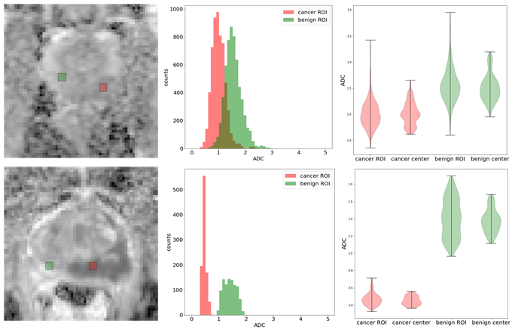
Methods:
Our methodology is built on the observation that inter-acquisition variation of DWI is larger than variation due to Rician noise and anisotropy [10]
A 3T dStream Ingenia (Philips) scanner was used to gather raw data from 10 biopsy-proven prostate cancer patients.
High-b DWI series were produced using with TE = 57 ms and b = 1500 s/mm² for endorectal coil protocol, and with TE = 63 ms and b = 900 s/mm² for non-endorectal coil protocol.
12 or 24 individual acquisitions were reconstructed using MRecon Matlab library (Gyrotools, Zurich, Switzerland).
Notes:
Our methodology is built on the observation that was presented by our group at ISMRM last year, that inter-acquisition variation of DWI is larger than variation due to Rician noise and anisotropy. For this, we scanned 10 biopsy-proven prostate cancer patients with endorectal and non-endorectal coils at high-b values of 1500 and 900 seconds per mm-squared for endorectal and non-endorectal coil scans, respectively. Then, instead of using the scanner’s dicom images, which are the average images, we reconstructed the individual acquisitions from raw data using Mrecon library of Gyrotools.

Slide 4
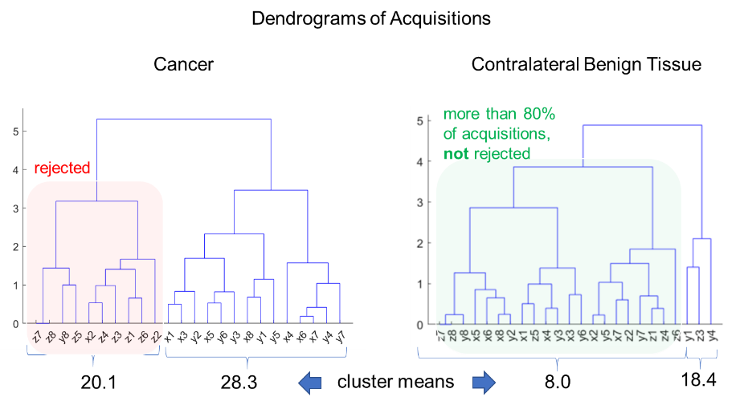
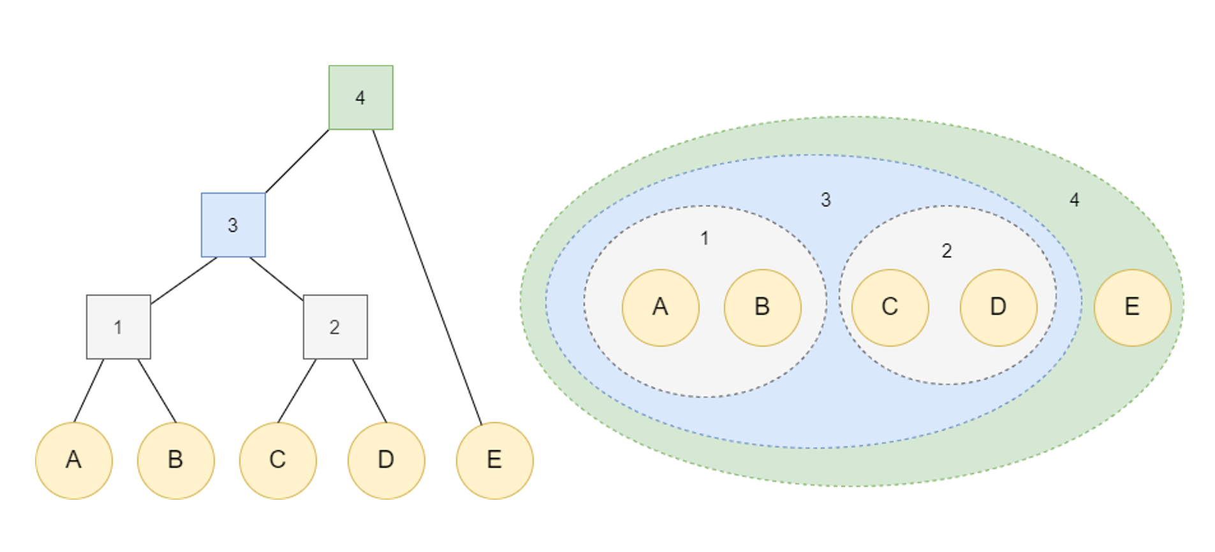
Methods:
Hierarchical Agglomerative Clustering
Idea : Cluster acquisitions (averages) into two clusters, then reject those with smaller mean and cardinality
Notes:
The idea is to automatically reject the acquisitions corrupted by motion induced signal loss, filter them out on a voxel-by-voxel basis and reconstruct the mean image using the remaining ones. For this we employed the hierarchical agglomerative clustering algorithm, which combines data points, which are acquisitions in our scenario, one by one based on their similarities until there’s only one cluster left. We ran the algorithm per-voxel until there are two clusters with the largest inter-cluster mean. Then the cluster with the lower mean is rejected unless its cardinality consists of 80% of the all acquisitions.

Slide 5
Results:
The clustering method filtered on average 49% of the acquisitions on prostate regions, where the inter-acquisition variation is higher.
This detects voxels with cancer that the mean image misses.
It is more effective on NERC images and cancers with low conspicuity.
Notes:
As a result, The clustering method filtered on average 49% of the acquisitions on prostate regions, where the inter-acquisition variation is higher.
Also, the resulting mean images detect voxels with cancer that the mean image misses. One other observation is that it is more effective on non-enodorectal coil images and on cancers with low conspicuity.

Slide 6
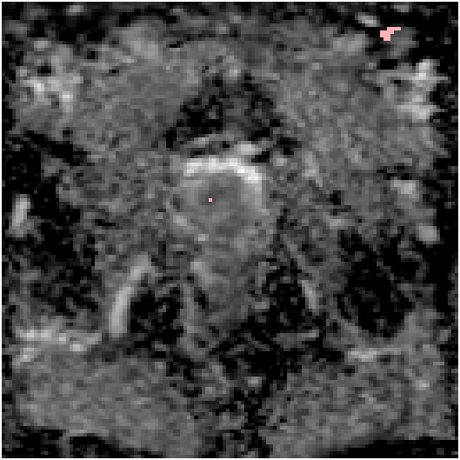
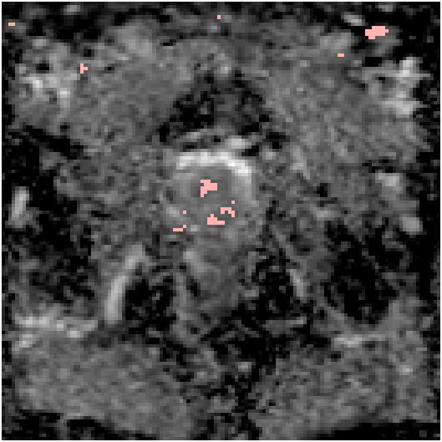
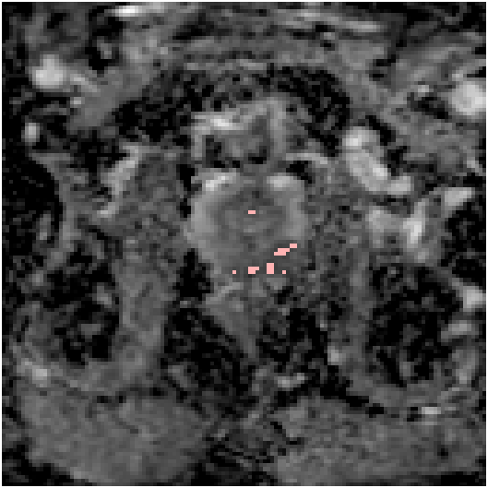
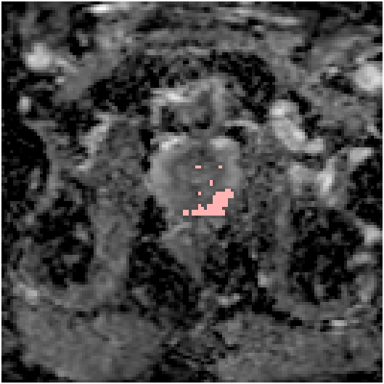
Results:
Notes:
In these two figures we see two patients both with Gleason score 4+3 cancers. The cancer areas are marked with white ROIs. The red markers depict the voxels with ADCs less than 1.04 millimeter square per second, which is the value for prostate cancer detection in MR Literature. (click)The processed images detect the cancer voxels that the mean image misses.

Slide 7
Conclusion:
We proposed a method to filter the motion-corrupted images in an unsupervised fashion to be applied prior to averaging.
This method is effective when some of the acquisitions suffer from motion-induced signal loss.
Per-voxel clustering can also be conducted by including the neighboring voxels to improve SNR and CNR, but this comes with a cost of lower resolution.
Notes:
In conclusion We proposed a method to filter the motion-corrupted images in an unsupervised fashion to be applied prior to averaging.
This method is effective when some of the acquisitions suffer from motion-induced signal loss.
Also -- Per-voxel clustering can also be conducted by including the neighboring voxels to improve SNR and CNR, but this comes with a cost of lower resolution.

Slide 8
References:
1. Schoots IG, Padhani AR. Delivering Clinical impacts of the MRI diagnostic pathway in prostate cancer diagnosis. Abdom Radiol (NY). 2020;45(12):4012-22.
Westphalen AC. Introduction to the special issue: Prostate Cancer Update. Abdom Radiol (NY). 2020;45(12):3947.
3. Kitajima K et al. High b-value diffusion-weighted imaging in normal and malignant peripheral zone tissue of the prostate: effect of signal-to-noise ratio. Magnetic Resonance in Medical Sciences 2008; 7(2): 93–99.
Kwee et al. Influence of cardiac motion on diffusion-weighted magnetic resonance imaging of the liver. Magnetic Resonance Materials in Physics, Biology and Medicine 2009; 22(5): 319–325.
6. Nasu K at al. Hepatic pseudo-anisotropy: a specific artifact in hepatic diffusion-weighted images obtained with respiratory triggering. Magnetic resonance materials in physics, biology and medicine 2007; 20(4): 205–211.
7. Hernando D, Zhang Y, Pirasteh A. Quantitative diffusion MRI of the abdomen and pelvis. Medical Physics 2021.
8. Luna A et al. Diffusion-weighted imaging of the chest. Magnetic Resonance Imaging Clinics 2011 19(1): 69–94.
Gurney-Champion et al. Minimizing the acquisition time for intravoxel incoherent motion magnetic resonance imaging acquisitions in the liver and pancreas. Investigative radiology 2016; 51(4): 211–220.
Jay M. Pittman et al. Directional and Inter-acquisition Variability in DWI (DAVID), ISMRM (2021)
Acknowledgments:
This work was supported by the Sanford J. Grossman Charitable Trust (Sanford J. Grossman Center of Excellence in Prostate Imaging and Image Guided Therapy)
Notes:
The references cited in this work is provided in the slide. This work was supported by the Sanford J. Grossman Charitable Trust

